Slide 1
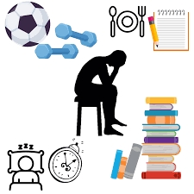
Examining the Influence of Lifestyle Factors on GPA of Students in India: A Linear Regression Analysis
By Cheki Wangchuk

Slide 2

Overview
Introduction
Literature Review
Theoretical Framework
Materials and Methods
Results and Findings
Conclusion

Slide 3

Introduction
Academic performance (GPA) is a crucial measure of student success.
While cognitive ability is a key determinant, lifestyle factors such as study habits, extracurricular activities, sleep patterns, and physical activity also play influential roles.
Effective time management and focused study practices are essential for academic success.

Slide 4




Literature Review
Overview of Key Factors
Study Hours
Extracurricular Activities
Positive correlation with GPA (Nonis & Hudson, 2010; Broadbent & Poon, 2015).
Quality of study time is crucial (Plant et al.,2005).
Moderate participation can enhance GPA (Munir & Zaheer, 2021).
Excessive participation may hinder academic performance (Eccles et al., 2003).
Sleep Patterns
Physical Activity
Adequate sleep supports cognitive functions essential for academic success (Hershner & Chervin, 2014; Wheaton et al., 2015).
Physical activity has been linked to improved cognitive function and academic performance (Sibley & Etnier, 2003; Trockel et al., 2000).

Slide 5

Theoretical Framework
Self-Regulated Learning (SRL) Theory (Zimmerman, 2002)
Emphasizes effective time management and goal-setting.
The present study applies SRL theory to investigate how variables such as study hours, sleep patterns, and participation in extracurricular activities influence students’ ability to self-regulate their learning and, consequently, their GPA.
Tinto’s Student Integration Theory (Tinto, 1993)
Highlights the importance of academic and social integration for success.
This theory provides a lens for examining how extracurricular involvement and physical activity contribute to students’ sense of belonging and institutional commitment that lead to academic success.

Slide 6


Materials and Methods
Utilized a dataset of 2,000 student records from India (2023-2024) collected by Sulaniishara (2024).
Multiple linear regression analysis was conducted using Jamovi software to examine the impact of study hours, extracurricular activities, sleep hours, and physical activity on GPA.

Slide 7

Results and Findings
Table 1
Descriptive Statistics of Key Variables
 | Study_Hours_Per_Day | Extracurricular_Hours_Per_Day | Sleep_Hours_Per_Day | Physical_Activity_Hours_Per_Day | GPA
N | 2000 | 2000 | 2000 | 2000 | 2000
Missing | 0 | 0 | 0 | 0 | 0
Mean | 7.476 | 1.990 | 7.501 | 4.328 | 3.116
Median | 7.400 | 2.000 | 7.500 | 4.100 | 3.110
Standard deviation | 1.424 | 1.156 | 1.461 | 2.514 | 0.299
Minimum | 5.000 | 0.000 | 5.000 | 0.000 | 2.240
Maximum | 10.000 | 4.000 | 10.000 | 13.000 | 4.000

Slide 8
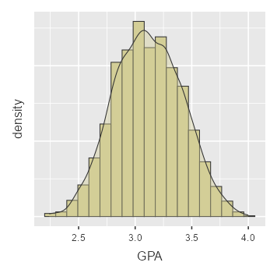
Figure 1
Distribution of GPA Scores with Histogram and Density Plot

Slide 9
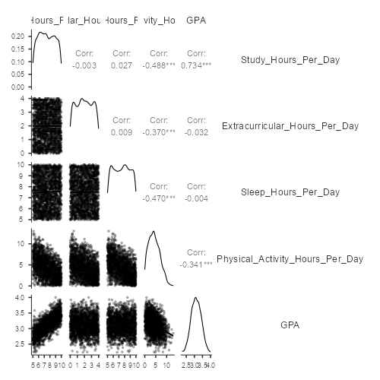
Figure 2
Relationships between study hours, extracurricular hours, sleep hours, physical activity hours, and GPA.

Slide 10
Table 2
Model Coefficients for GPA Prediction
Predictor | Estimate | SE | T | p
Intercept | 2.039 | 0.061 | 33.525 | <.001
Study_Hours_Per_Day | 0.153 | 0.004 | 38.700 | <.001
Extracurricular_Hours_Per_Day | -0.009 | 0.005 | -1.954 | 0.048
Sleep_Hours_Per_Day | -0.006 | 0.004 | -1.546 | 0.122
Physical_Activity_Hours_Per_Day | -0.001 | 0.003 | -0.471 | 0.638

Slide 11
Table 3
Model Fit Measures
Model | R | R² | Adjusted R² | AIC
1 | 0.736 | 0.541 | 0.540 | -704.132
Note. Models estimated using sample size of N=2000

Slide 12
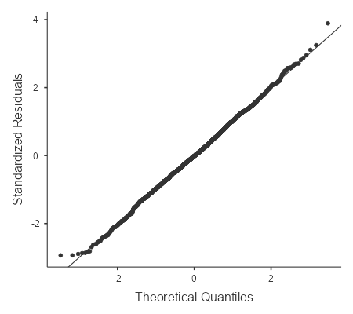
Figure 3
Q-Q Plots for Normality Test

Slide 13

Conclusion
The study supports SRL and Tinto’s theories, highlighting the significance of structured study habits and balanced extracurricular involvement.
Future research could explore additional factors like mental health, nutrition, and technology's role in academic performance.

Slide 14
Reference
Ahmed, A. A., & Muhammad, R. A. (2021). A Beginners Review of Jamovi Statistical Software for Economic Research. Dutse International Journal of Social and Economic Research, 6(1), 109–118. https://www.researchgate.net/publication/354077071_A_Beginners_Review_of_Jamovi_Statistical_Software_for_Economic_Research
Broadbent, J., & Poon, W. (2015). Self-regulated learning strategies & academic achievement in online higher education learning environments: A systematic review. The Internet and Higher Education, 27, 1–13. https://doi.org/10.1016/j.iheduc.2015.04.007
Eccles, J. S., Barber, B. L., Stone, M., & Hunt, J. (2003). Extracurricular activities and adolescent development. Journal of Social Issues, 59(4), 865–889. https://doi.org/10.1046/j.0022-4537.2003.00095.x
Fredricks, J. A., & Eccles, J. S. (2006). Is extracurricular participation associated with beneficial outcomes? Concurrent and longitudinal relations. Developmental Psychology, 42(4), 698–713. https://doi.org/10.1037/0012-1649.42.4.698
Gilbert, S. P., & Weaver, C. C. (2010). Sleep quality and academic performance in university students: A Wake-Up call for college psychologists. Journal of College Student Psychotherapy, 24(4), 295–306. https://doi.org/10.1080/87568225.2010.509245
Hershner, S., & Chervin, R. (2014). Causes and consequences of sleepiness among college students. Nature and Science of Sleep, 73. https://doi.org/10.2147/nss.s62907
Munir, S., & Zaheer, M. (2021). The role of extra-curricular activities in increasing student engagement. AAOU Journal, 16(3), 241–254. https://doi.org/10.1108/aaouj-08-2021-0080
Nonis, S. A., & Hudson, G. I. (2010). Performance of college students: Impact of study time and study habits. Journal of Education for Business, 85(4), 229–238. https://doi.org/10.1080/08832320903449550

Slide 15
Reference
Plant, E. A., Ericsson, K. A., Hill, L., & Asberg, K. (2004). Why study time does not predict grade point average across college students: Implications of deliberate practice for academic performance. Contemporary Educational Psychology, 30(1), 96–116. https://doi.org/10.1016/j.cedpsych.2004.06.001
Sibley, B. A., & Etnier, J. L. (2003). The relationship between physical activity and cognition in children: A meta-analysis. Pediatric Exercise Science, 15(3), 243-256. http://dx.doi.org/10.1515/ijsl.2000.143.183
Sulaniishara. (2024, November 22). Student Stress & Performance Insights. https://www.kaggle.com/code/sulaniishara/student-stress-performance-insights/input
Tinto, V. (1993). Leaving college: Rethinking the causes and cures of student attrition. University of Chicago Press. https://doi.org/10.7208/chicago/9780226922461.001.0001
Trockel, M. T., Barnes, M. D., & Egget, D. L. (2000). Health-related variables and academic performance among first-year college students: Implications for sleep and exercise. Journal of American College Health, 49(3), 125-131. https://psycnet.apa.org/doi/10.1080/07448480009596294
Wheaton, A. G., Ferro, G. A., & Croft, J. B. (2015). School start times for middle school and high school students — United States, 2011–12 school year. MMWR Morbidity and Mortality Weekly Report, 64(30), 809–813. https://doi.org/10.15585/mmwr.mm6430a1
Zimmerman, B. J. (2002). Becoming a self-regulated learner: An overview. Theory into Practice, 41(2), 64-70. https://doi.org/10.1207/s15430421tip4102_2

Slide 16


Slide 17


